Slide 1
Radix-2 Fast Fourier Transforms: Performance Analysis of Sequential and Different Parallel Approaches
Shady Boukhary

Slide 2
Outline
CPU vs GPU
What is a Fast Fourier Transform?
FFT Visualized
Sequential vs Parallel Approaches to FFT
OpenACC vs CUDA
System Specifications and Results
Further Analysis using Matrix Multiplication
Conclusion
Questions

Slide 3
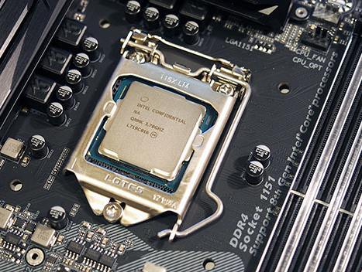
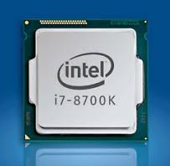
Central Processing Unit (CPU)
Used for most computations
Large, highly-clocked, few powerful cores
Great for sequential tasks
Typically has 4-8 cores and 8-16 threads
“Single Core” or “Multi-core” architecture

Slide 4
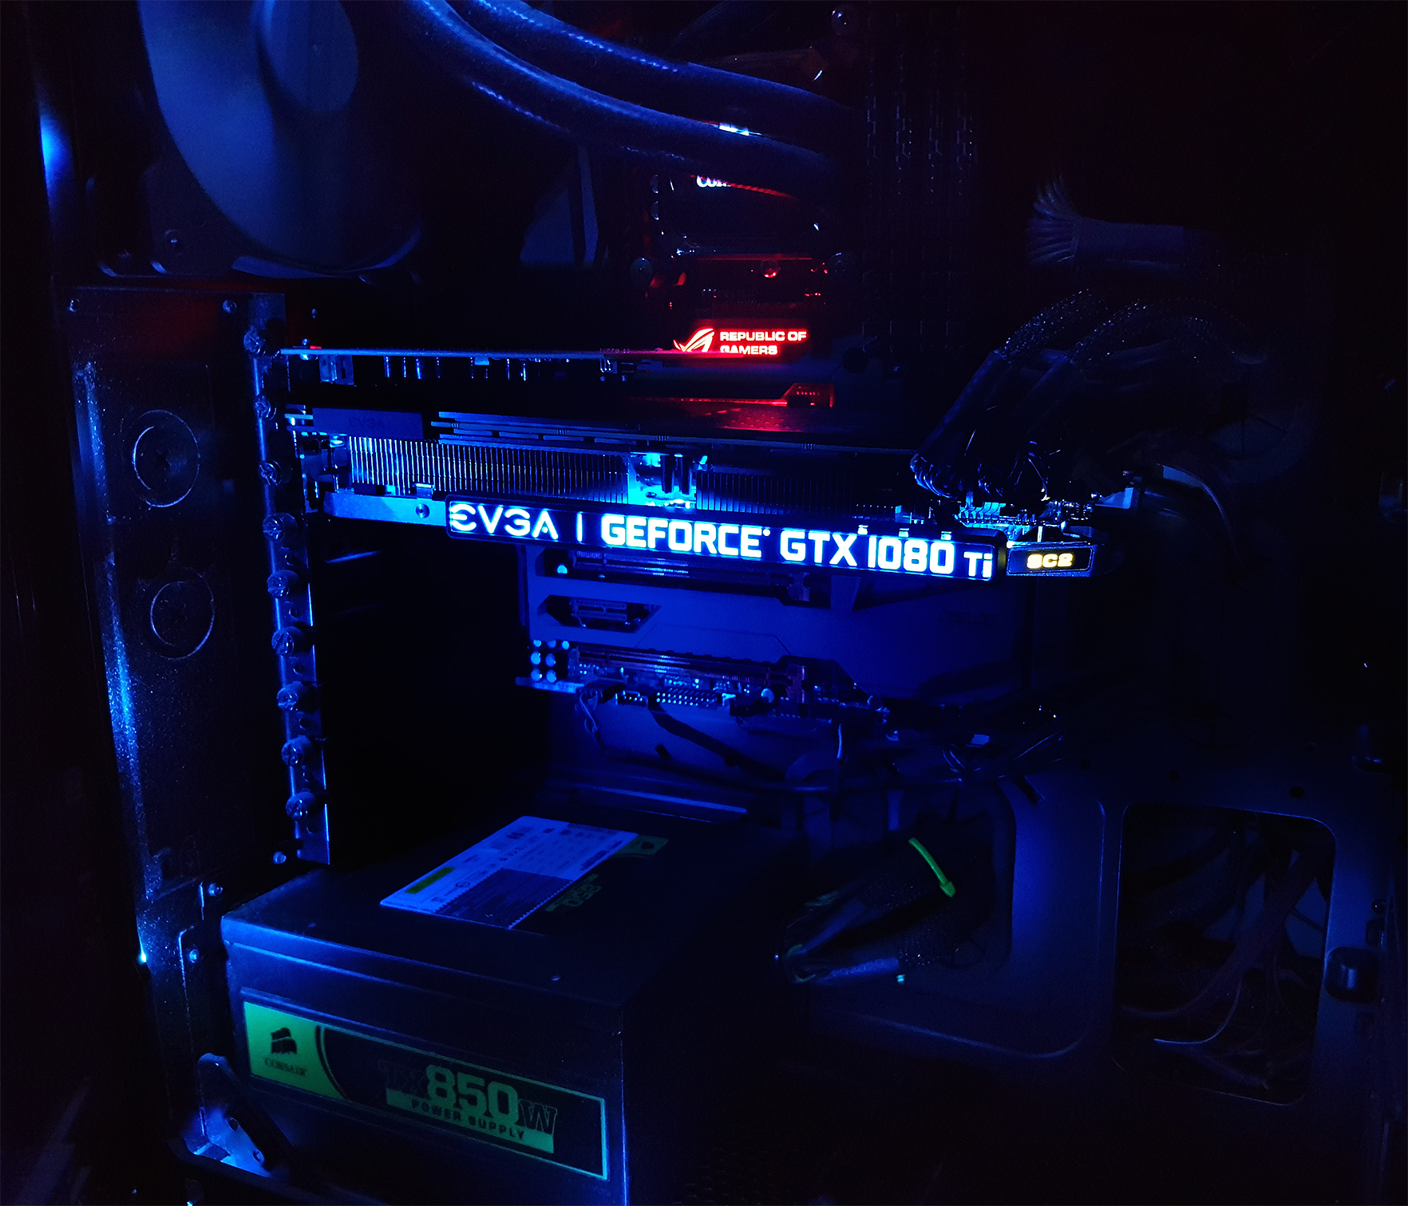
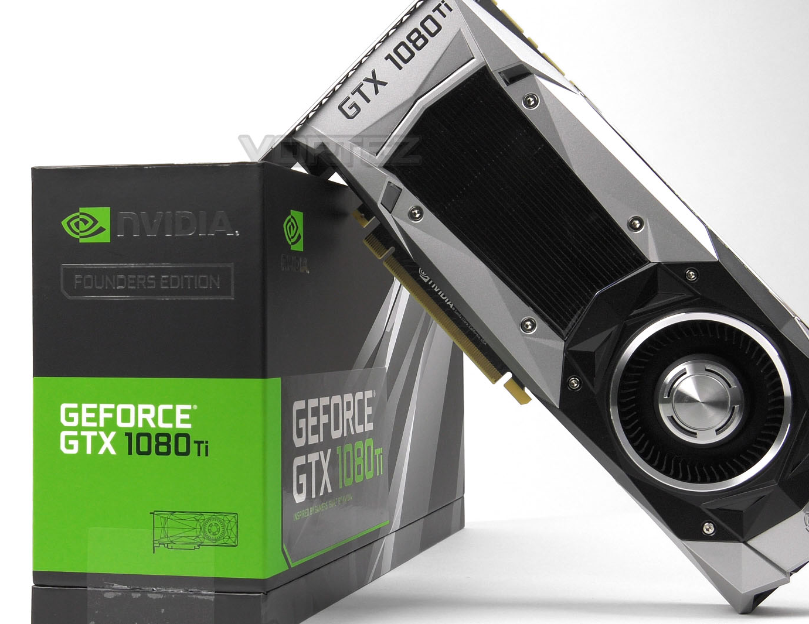
Graphics Processing Unit (GPU)
Lead the floating point race since 2003
Can contain thousands of CUDA cores
Cores clocked lower than CPU cores
“Many-core” architecture
Great at parallel tasks (multi-media, games, parallel programs)
Provides a very significant performance boost in parallel tasks
At the core of Machine Learning and Artificial Intelligence

Slide 5
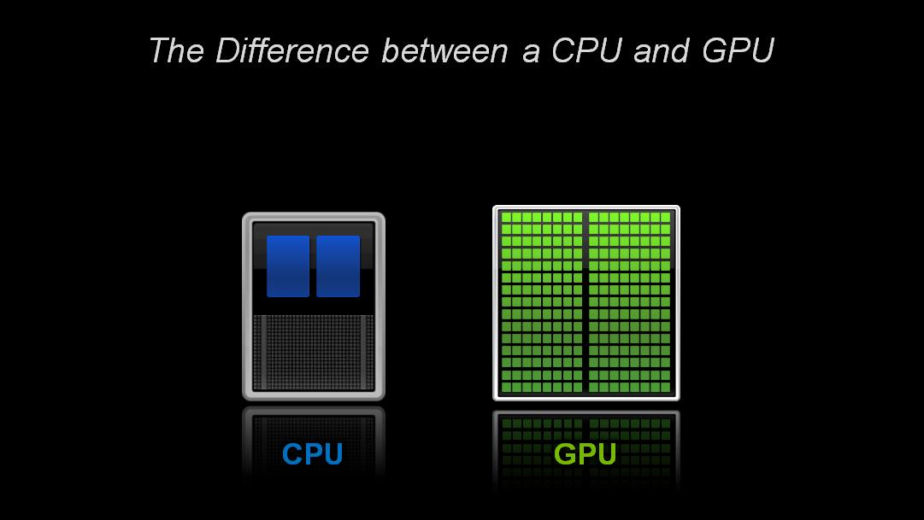
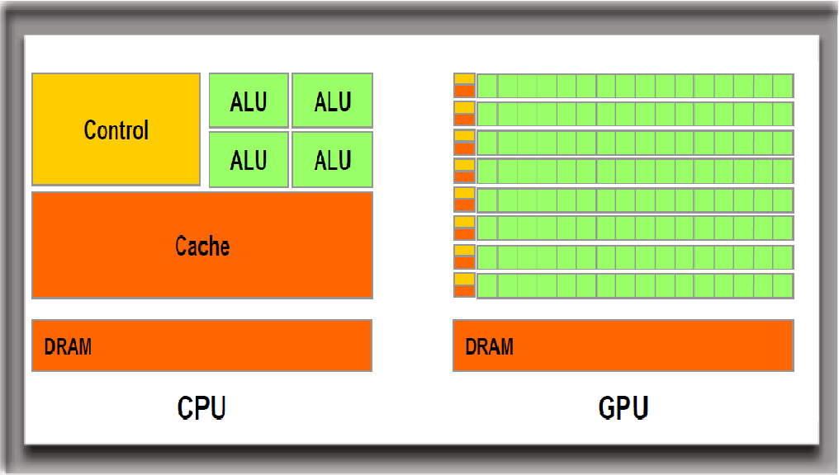
CPU vs GPU
Quality vs Quantity
Both have pros and cons

Slide 6
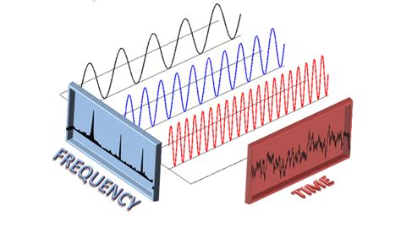
What is a Fast Fourier Transform?
Time-based pattern ➔ a bunch of circular pathways
Time domain ➔ frequency domain
Measures every possible cycle
Returns the overall cycle (the amplitude, offset, & rotation speed for every cycle that was found)

Slide 7
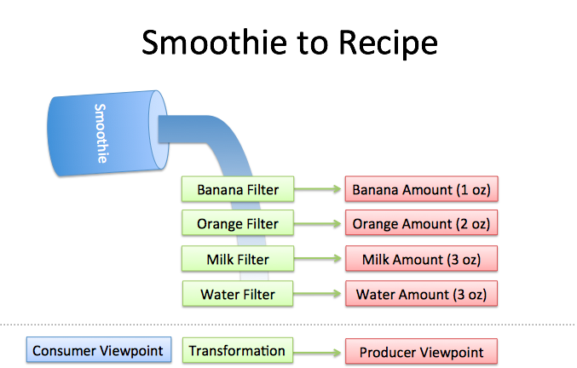
What is a Fast Fourier Transform? Cont.
Think of a smoothie
Find the recipe using filters
Recipes are easier to analyze, modify and compare
Blend ingredients to get the smoothie back

Slide 8
What is a Fast Fourier Transform? Cont.
Let’s visualize how it works

Slide 9
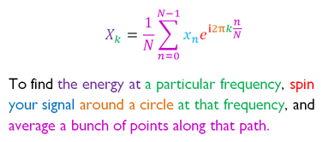
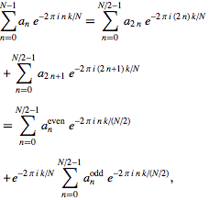
FFT Equations
N = number of time samples we have
n = current sample we're considering (0 .. N-1)
x_{n} = value of the signal at time n
k = current frequency we're considering (0 Hertz up to N-1 Hertz)
X_{k} = amount of frequency k in the signal (amplitude and phase, a complex number)

Slide 10
Sequential vs Parallel Approach
Sequential
Parallel
Loop through to compute all frequencies
Loop through data for each frequency
Perform Computation
Complexity: O(nLog₂n)
Each thread computes result for 1 frequency
Loop through data only
Perform Computation
Complexity O(Log₂n)

Slide 11
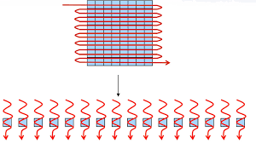
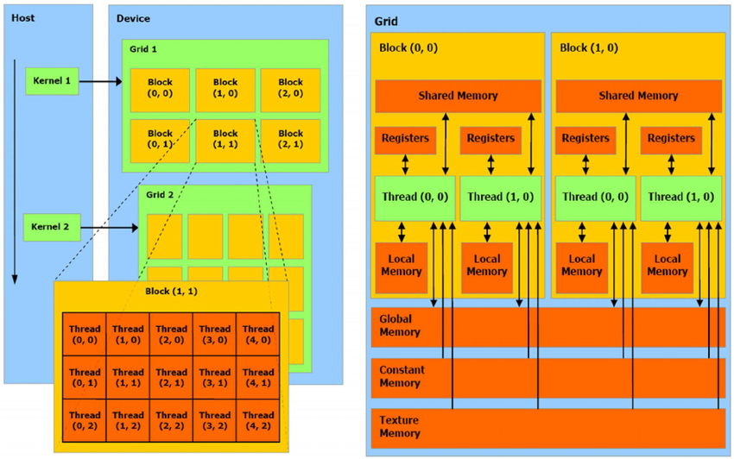
Sequential vs Parallel cont.
Grid divided into Blocks divided into Threads
Global Memory
Shared Memory

Slide 12
Two Parallel Approaches: OpenACC vs CUDA
OpenACC
CUDA
Set of compiler directives
Parallelize sequential code
Little to no GPU knowledge
Little to no overhead
Very easy to implement
GPU code auto-generated
Can use shared memory
Parallel code (kernel)
Knowledge of GPU architecture needed
More knowledge = better optimization
Not easy to implement
More code overhead
Can use either shared memory

Slide 13
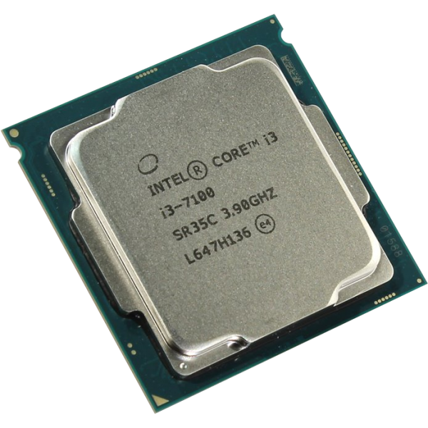
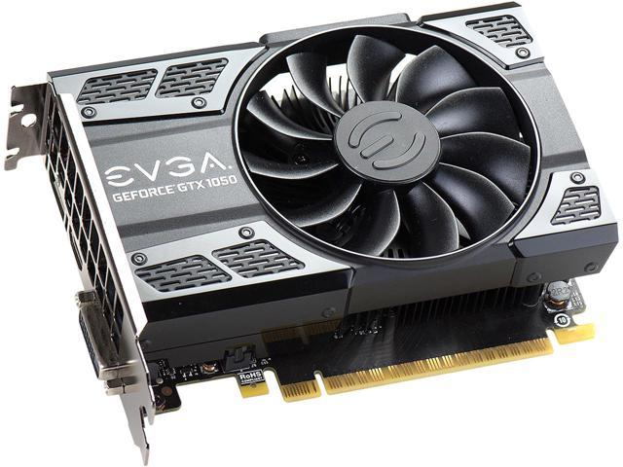
Tests ran on
CPU: Intel Core i3-7100
GPU: Nvidia GeForce GTX 1050 Ti
Frequency: 3.9GHz
Architecture: Kaby Lake
CPU Cores: 2
Threads: 4
Frequency: 1.39GHz
Architecture: Pascal
CUDA Cores: 768
Threads: 1024 per block
Memory: 4GB GDDR5

Slide 14
4096 Threads
4 Blocks
16,384 Threads
16 Blocks
65,536 Threads
64 Blocks
262,144 Threads
256 Blocks
1,048,576 Threads
1024 Blocks

Slide 18
…Then why even bother with CUDA?
OpenACC parallelization is not always consistent
Freedom to manually optimize with CUDA
Performance depends on Compiler and not programmer skill
Example: Matrix Multiplication

Slide 19
Matrix Multiplication Performance
Size/System | Intel Core i3-7100 CPU @ 3.90GHz (CPU) Nvidia Geforce GTX 1050 TI (GPU)
 | Method | Speed(seconds) | Speedup(Ts/Tp)
512x512 | Sequential | 5.906498e-01
 | OpenACC | 1.162069e-01 | 5.083 (508.3%)
 | CUDA Global Memory | 2.288103e-03 | 258.14 (25814%)
 | CUDA Shared Memory | 1.162052e-03 | 508.282 (50828.2%)
1024x1024 | Sequential | 13.35325
 | OpenACC | 1.308241e-01 | 102.07 (10207%)
 | CUDA Global Memory | 1.847792e-02 | 722.67 (72267%)
 | CUDA Shared Memory | 9.077072e-03 | 1471.099 (147
2048x2048 | Sequential | 106.4078
 | OpenACC | 3.450470e-01 | 308.386 (30838.6%)
 | CUDA Global Memory | 1.281788e-01 | 830.151 (83015.1%)
 | CUDA Shared Memory | 7.176995e-02 | 1482.623 (148262.3%)
4096x4096 | Sequential | 874.135
 | OpenACC | 1.7556 | 497.912 (49791.2%)
 | CUDA Global Memory | 1.0862 | 804.764 (80476.4%)
 | CUDA Shared Memory | 5.1807e-01 | 1687.291 (168729.1%)
8192x8192 | Sequential | 5760.748
 | OpenACC | 12.68030 | 454.306 (45430.6%)
 | CUDA Global Memory | 8.737388 | 659.321 (65931.1%)
 | CUDA Shared Memory | 3.633853 | 1585.30 (158530%)
16384x16384 | Sequential | ~46085.98
 | OpenACC | 115.624 | 398.584
 | CUDA Global Memory | 105.2529 | 438.914
 | CUDA Shared Memory | 28.39943 | 1645.937

Slide 23
Conclusion
Cannot parallelize problem ➔ Sequential code
Performance is a priority? ➔ CUDA
Quickly parallelize code ➔ OpenACC
Speedup legacy code ➔ OpenACC
Thoughts on openACC

Slide 24

Questions?

